Slide 1
TDD Overview CS 4501/6501 Software Testing
[Lasse Koskela, “Test Driven”, Chapters 2-3]

Slide 2
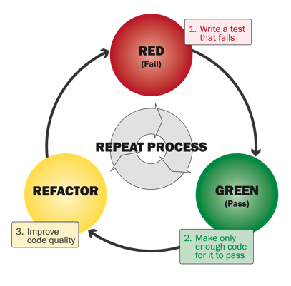
TDD Cycle

Slide 3
Overview
From requirements to tests
Choosing the first test
Breadth-first, depth-first
Let’s not forget to refactor
Adding a bit of error handling
Loose ends on the test list

Slide 4
1. From Requirements To Tests
The first step in TDD is writing a failing test,
we need to figure out what desired behavior we’d like to test for
Decomposing requirements
Template system as tasks – “things we need to do”
When completed, lead to satisfying the original requirements
Template system as tests – “thing we need to verify”
When passing, lead to the requirements being satisfied

Slide 5
Exercise: Requirements
Imagine we are implementing a subsystem for the corporate email application.
This subsystem is responsible for providing mail-template functionality so that the CEO’s assistant can send all sorts of important, personalized emails to all personnel with a couple of mouse-clicks.
How would tests drive the development of this subsystem.

Slide 6
Example: Tasks vs. Tests
Imagine you are implementing a subsystem for an email application
Template system as tasks
Write a regular expression for identifying variables from the template
Implement a template parser that uses the regular expression
Implement a template engine that provides a public API and uses the template parser internally
…
Template system as tests
Template without any variables renders as is
Template with one variable is rendered with the variable replaced with its value
Template with multiple variables is rendered with the appropriate placeholders replaced by the associated values
…
Idea of what we should do, easy to lose sight of the ultimate goal – not represent progress of the produced software
Idea of what should be done – connect to capabilities of the produced software
[Koskela, p. 46]

Slide 7
What Are Good Tests Made Of?
Tests are generally better than tasks for guiding our work, but does it matter what kind of tests we write?
Sure it does!
Two properties of a good test
A good test is atomic
Keeps things small and focused
A good test is isolated
Doesn’t depend on other tests

Slide 8
Programming by Intention
Given an initial set of tests, pick one that is potentially lead to most progress with least effort
Write test code
How to test something that doesn’t exist without breaking our test?
Imagine code exists
Benefit of programming by intention
Focus on what we could have instead of what we do have

Slide 9
2. Choosing the First Test
Restrict focus, do not worry about the whole system
Before coming up with an initial list of tests, define a set of requirements for the subsystem under test
Example requirements:
System replaces variable placeholders like ${firstname} in a template with values provided at runtime
Attempt to send a template with undefined variables raises error
System ignores variables that are not in the template
Example corresponding tests:
Evaluating template “Hello, ${name}” with value “Reader” results in “Hello, Reader”
Evaluating “${greeting}, ${name}” with “Hi” and “Reader” result in “Hi, Reader”
Evaluating “Hello, ${name}” with “name” undefined raises MissingValueError
Requirements
More concrete, more executable, more example-like
Tests

Slide 10
Writing The First Failing Test
We got a list of tests that tell us exactly when the requirements have been fulfilled. Now, we start working through the list, making them pass one by one
Consider the following test
Evaluating template “Hello, ${name}” with value “Reader” results in “Hello, Reader”
Now, let’s create a JUnit test

Slide 11
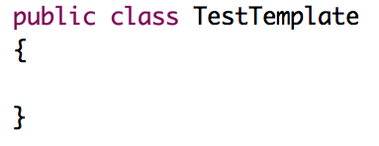
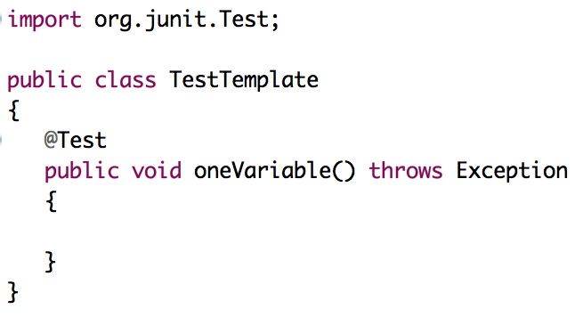
Example
Step 1: Creating a skeleton for our tests
Step 2: Adding a test method

Slide 12
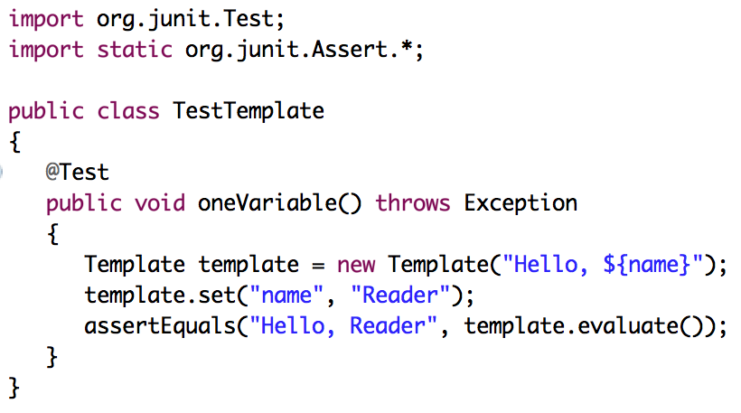
Example
Step 3: Writing the actual test
assuming that the implementation is there (even though it isn’t)

Slide 13
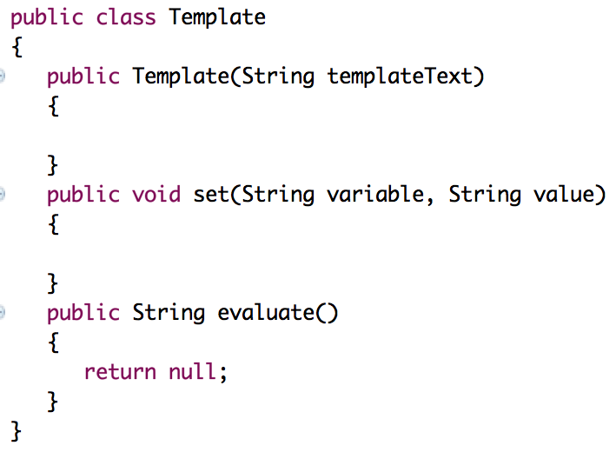
Example
Now, the compiler points out that there is no such constructor for Template that takes a String as a parameter
Step 4: Satisfying the compiler by adding empty methods and constructors

Slide 14
Example
Step 5: Running test
Yes, the test fails – not surprisingly, because we haven’t implemented the methods yet
Benefit: to check that the test is executed, not the test result
The red phase of the TDD cycle

Slide 15
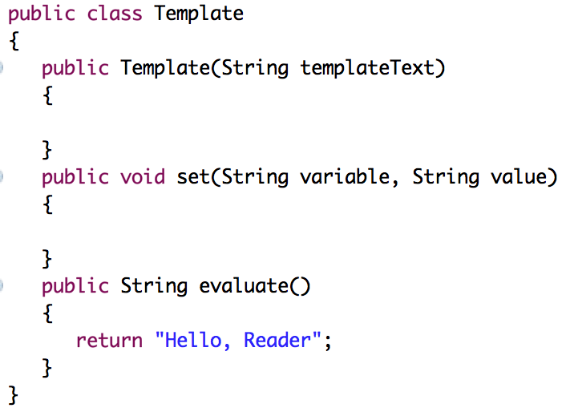
Example
Step 6: Making the first test pass
Passing as quickly as possible with a hard-coded return statement
The green phase of the TDD cycle

Slide 16
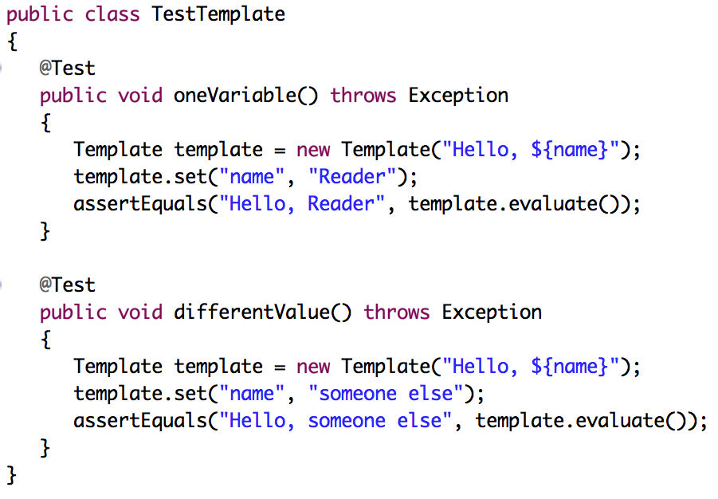
Example
Step 7: Writing another test
Passing as quickly as possible with a hard-coded return statement
Forcing out the hard-coded return statement with another test
The hard-coded evaluate method in the Template class will no longer pass this test

Slide 17
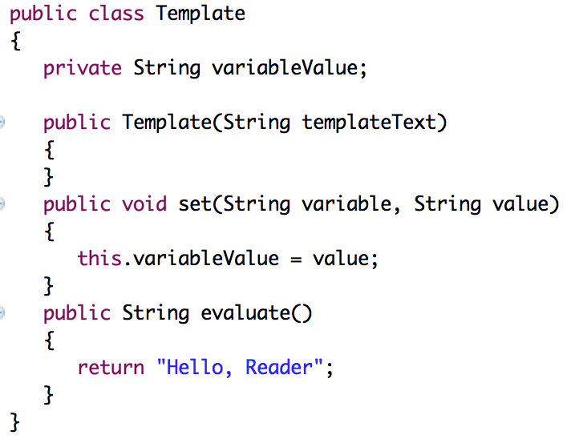
Example
Step 8: Revising code (to make the second test pass by storing and returning the set value)
Our test passes again with minimal effort
Our test isn’t good enough yet because of the hard-coded part
To improve the test’s quality, follow three dimensions to push out code: variable, value, template

Slide 18
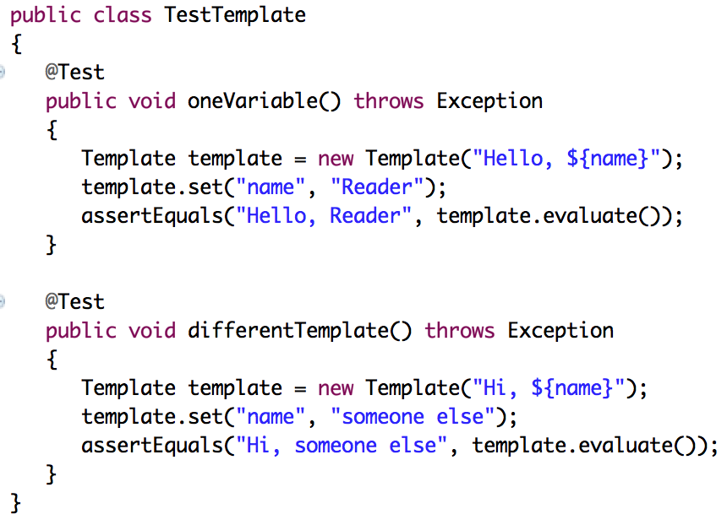
Example
Step 9: Revising test
Rename test to match what we’re going
Squeeze out more hard coding

Slide 19
3. Breadth-First, Depth-First
What to do with a “hard” red phase?
Issue is “What to fake” vs. “What to build”
“Faking” is an accepted part of TDD
That is, “deferring a design decision”

Slide 20
Breadth-First
Implement the higher-level functionality first by faking the required lower-level functionality
Template functionality
Template functionality
Template functionality
Faked
parsing
Faked
rendering
Parsing
Faked
rendering
Parsing
Rendering

Slide 21
Depth-First
Implement the lower-level functionality first and only compose the higher-level functionality once all the ingredients are present
Template functionality
Template functionality
Template functionality
Parsing
Faked
rendering
Parsing
Rendering
Parsing
Rendering

Slide 22
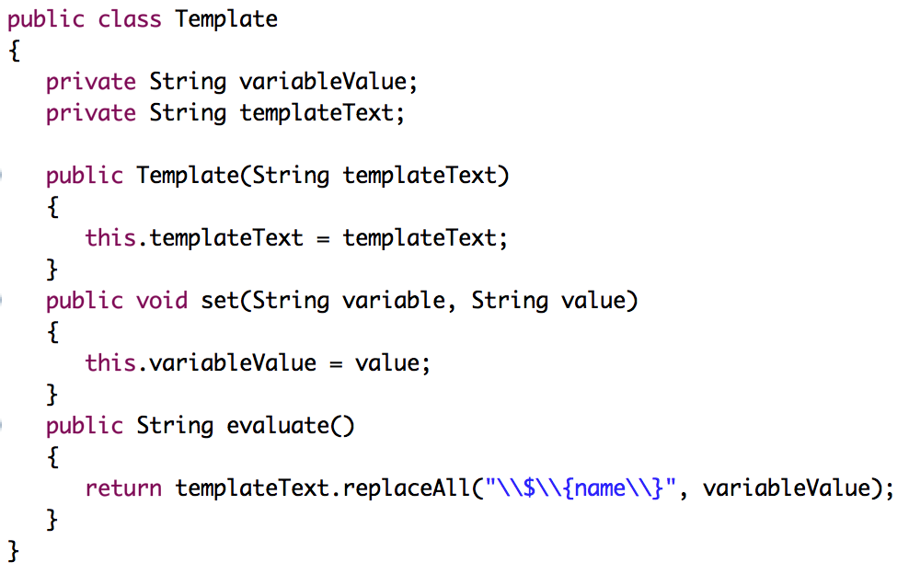
Faking Details a Little Longer
Handling variables as variables
Store the variable value and the template text somewhere
Make evaluate replace the place holder with the value

Slide 23
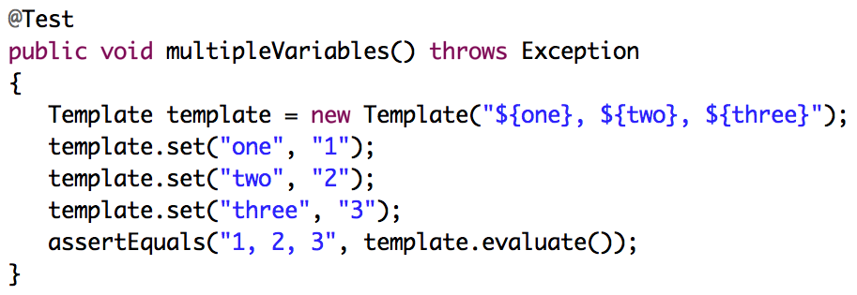
Squeezing Out The Fake Stuff
Writing test for multiple variables on a template
This test fails
To get the test passing as quickly as possible, do the search-and-replace implementation

Slide 24
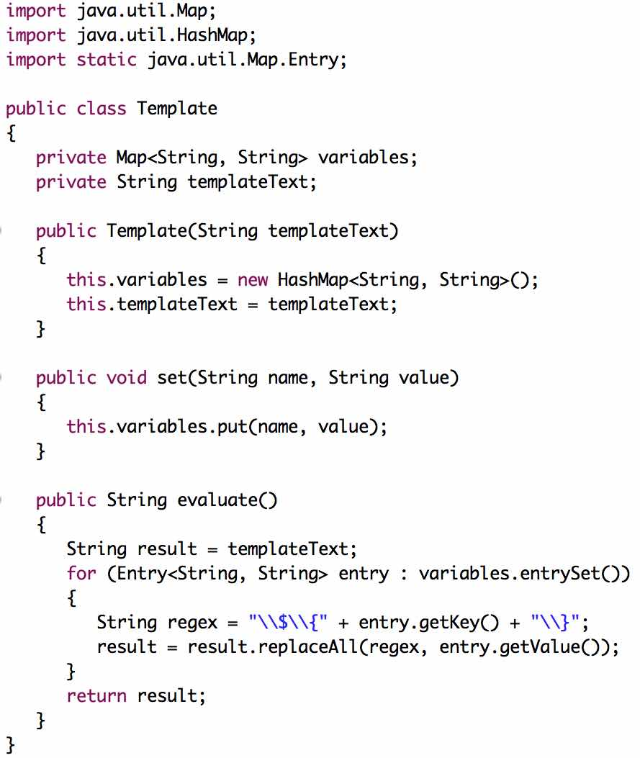
Solution to Multiple Variables
Store variable values in HashMap
Loop through variables value
Replacing each variable with its value

Slide 25
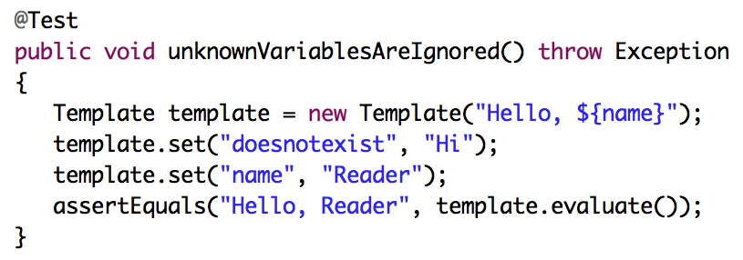
Special Test Case
Evaluating template “Hello, ${name}” with values “Hi” and “Reader” for variables “doesnotexist” and “name”, results in the string “Hello, Reader”
If we set variables that don’t exist in the template text, the variables are ignored by the Template class
This test passes without any changes

Slide 26
Why Red Then Green
We intentionally fail the test at first just to see that
Our test execution catches the failure
We are really executing the newly added test
Only then proceed to implement the test and see the bar turn green again

Slide 27
4. Let’s Not Forget To Refactor
At this point, it might seem that we didn’t add any code and there is nothing to refactor
Though we didn’t add any production code, we added test code, and that is code – just like any other
We don’t want to let our test code rot and get us into serious trouble later
What could we do about our test code?
Identify any potential refactoring
Decide which of them we’ll carry out
Refactoring applies to code and test code

Slide 28
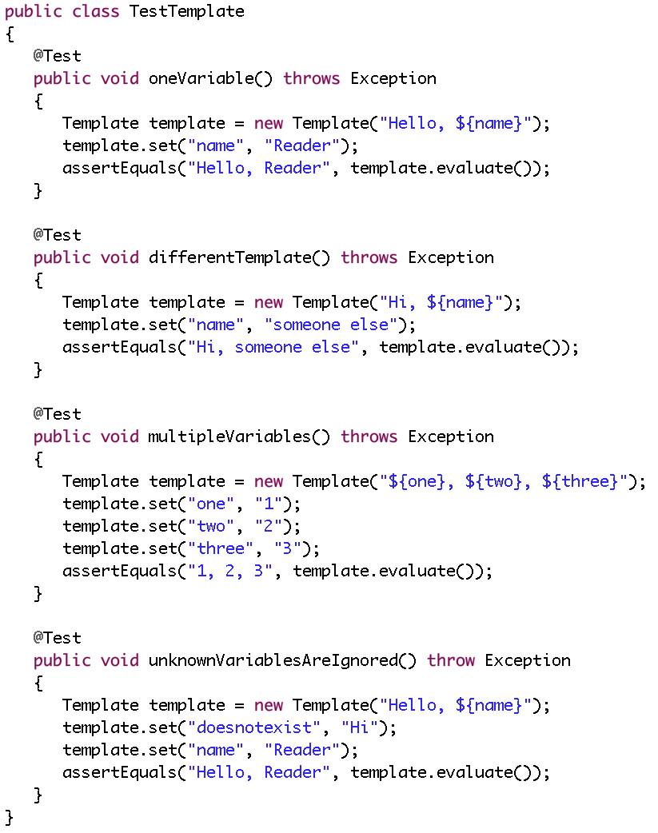
Example: Test Class So Far
Can you spot anything to refactor?

Slide 29
Potential Refactoring in Test Code
All tests are using a Template object
Solution: extract it into an instance variable rather than declare it over and over again, use fixtures
The evaluate method is called several times as an argument to assertEquals
Solution: write a method that calls the evaluate method
The Template class is instantiated with the same template text in two places
Solution: remove the duplicate by using fixtures (with some unified values)
Remove redundant tests

Slide 30
Revisit Current Test Class
Let’s consider duplication between these tests
multipleVariables covers oneVariable and differentTemplate
-- thus, get rid of them
unknownVariablesAreIgnored can use the same template text as multipleVariables

Slide 31
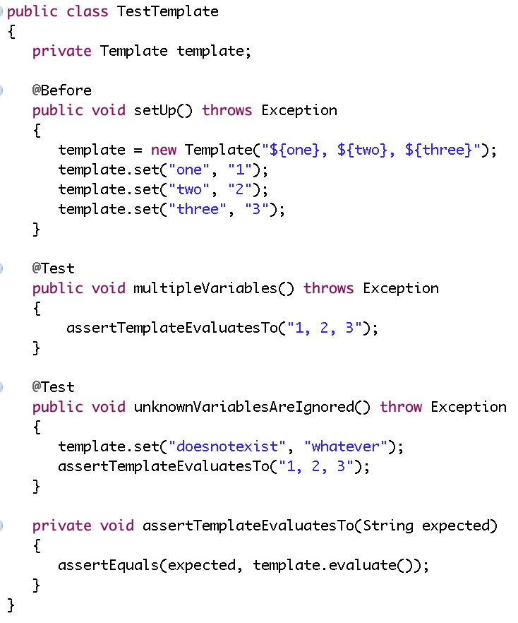
Refactored Test Code
Common fixture for all tests
Simple,
focused test
Now, let’s add more functionality – that is, add more tests

Slide 32
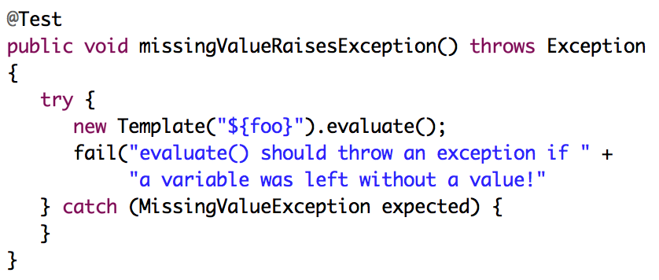
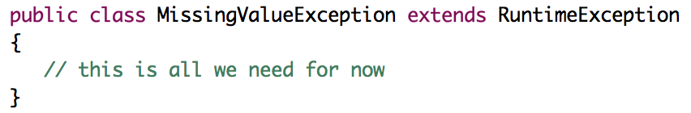
5. Adding a Bit of Error Handling
Add exception test, using try/catch block with fail()

Slide 33
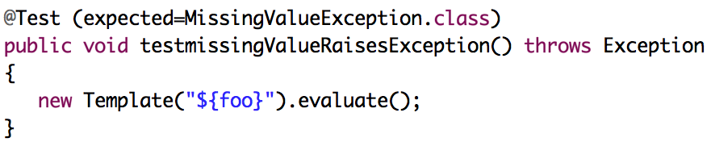
Adding a Bit of Error Handling (2)
Add exception test, using @Test (expected = …)
Except test (either try/catch with fail() or @Test (expected=…) fails.
That means, we have to somehow check the missing variables.
Let’s make the test pass
How to get to the green phase as quickly as possible?

Slide 34
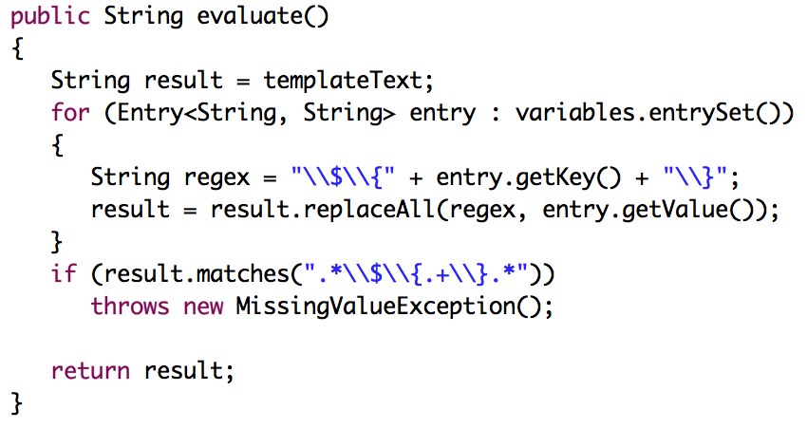
Writing Code To Make The Test Pass
How do we know inside evaluate, whether some of the variables specified in the template text are without a value?
Checking for remaining variables after the search-and-replace
Does it look like we left a variable in there?

Slide 35
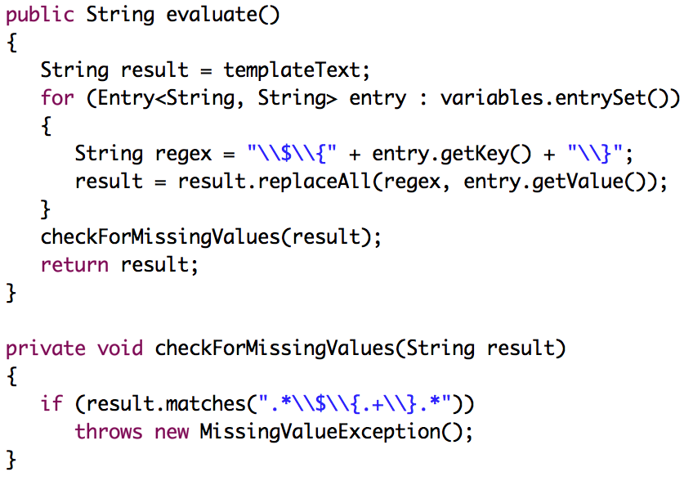
Refactoring Toward Small Methods
evaluate() is doing too many different things
Replacing variables with values, checking for missing values
Extracting the check for missing variables into its own method
Get rid of a whole if-block from evaluate()
Much better.
Is there still more to do?

Slide 36
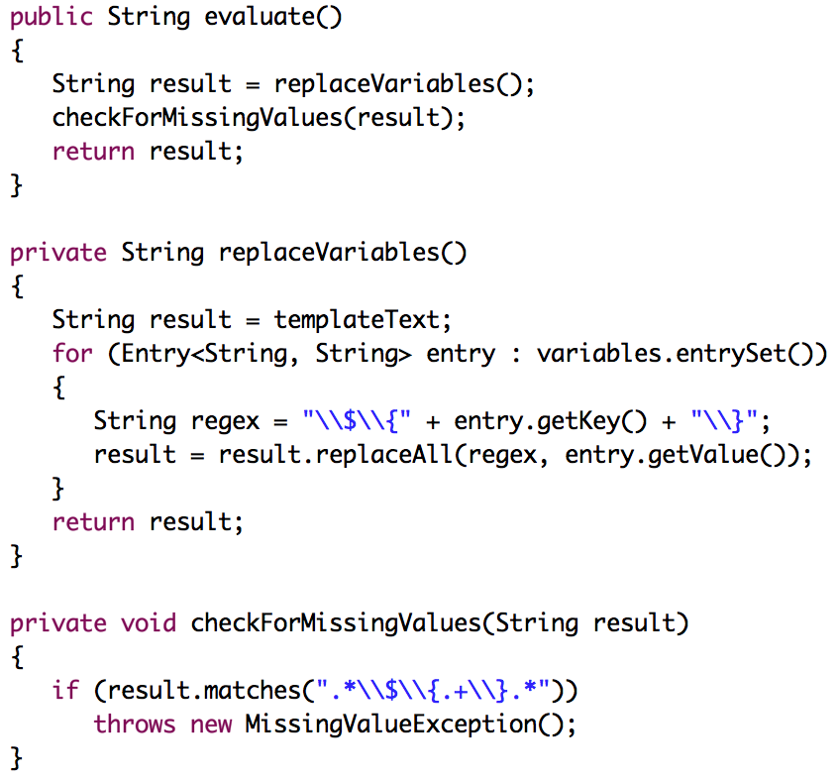
More Refactoring
evaluate() is still doing two things:
Replacing variables with values, checking for missing values
Extracting method refactoring
To create simple, single, clear purpose methods
Run tests again,
Nothing’s broken!

Slide 37
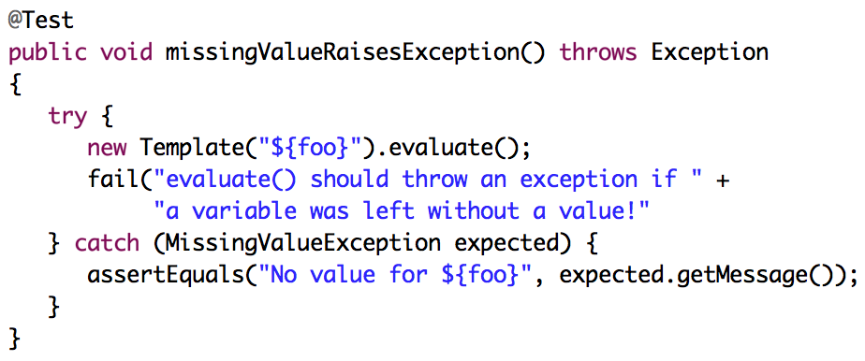
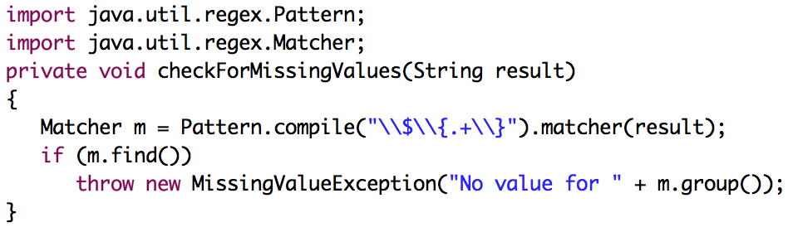
Adding Diagnostics to Exceptions

Slide 38
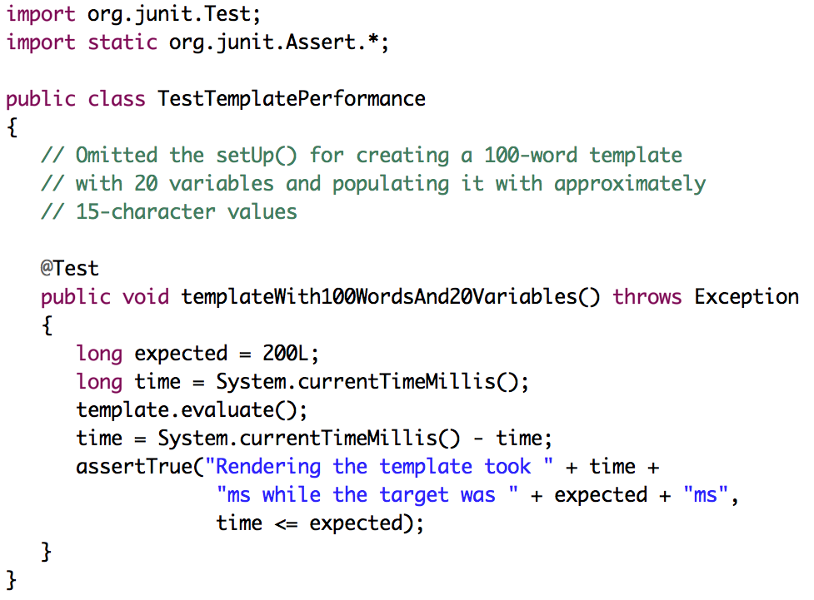
6. Loose Ends On The Test List
Testing for performance

Slide 39
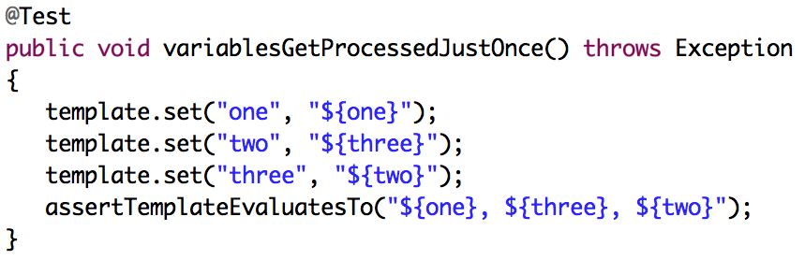
Test That Dooms Current Implementation
Write test that provides whether the code’s current behavior are correct

Slide 40
Summary
TDD
Test: write a test
Code: write code to make the test pass
Refactor: find the best possible design for what we have, relying on the existing tests to keep us from breaking things while we’re at it
Encourages good design, produces testable code, and keeps us away from over-engineering our system because of flawed assumptions

